Slide 1
PYTHON WITH AI
Prepared by Sir Haroon

Slide 2
LECTURE 19
File I/O Part-1

Slide 3
What is File I/O?
File I/O lets a program save data permanently to a file on disk, instead of losing it when the program ends (like lists and dictionaries do). For example,
open(filename, mode)
f = open(“data.txt”, “r”)

Slide 4
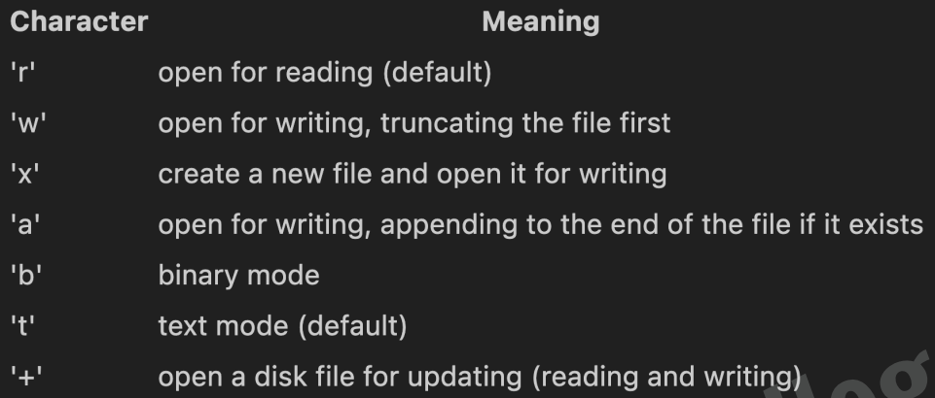
File Modes

Slide 5
Opening & Reading a File
f = open(“data.txt”, “r”)
content = f.read()
f.readline
f.close()

Slide 6
read(), readline(), readlines()
read() reads the whole file as one single string.
readline() reads only one line at a time.
readlines() reads all lines and returns them as a list.
f = open(“data.txt”, “r”)
print(f.readlines())

Slide 7
Writing AND DELETING to a File
f = open(“notes.txt”, “w”)
f.write(“AI is the future\n”)
f.write(“Python makes it easy\n”)
f.close()
Import os
os.remove(filename)

Slide 8
File I/O Usage in AI
Datasets for AI models are stored in files such as .csv, .json, and .txt, and loaded using File I/O before training.
Trained model weights are saved to files, so a model does not need to be retrained every time it is used.
Training logs are written to files so progress can be reviewed later, even after the program closes.

Slide 9
Exercise Questions
QUESTION 1: Ask the user for their name and a message, then save it inside a file called diary.txt
QUESTION 2: Open diary.txt and print its full contents on the screen

